Slide 1
Alpha Measurement and Control from a Supplier Perspective
Presented by
Jerry Cohn, President
PURE TECHNOLOGIES

Slide 2
I am Jerry Cohn, co-founder of Pure Technologies, and for almost 20 years now, we have been suppliers of low, ultra-low and super ultra-low alpha materials. I have been asked to present some information regarding alpha measurement and how we obtain consistency of alpha quality from a supplier’s perspective.

Slide 3
I will attempt to explain how we control the quality and consistency of our material without sounding like a commercial – a bit difficult to do. Of course I will not divulge proprietary information but will give you some glimpse into what we do to accomplish this.

Slide 4
PRODUCTION
We developed our proprietary process and have continued to improve it over the past 18 years. Like others, we begin with the best raw materials possible. Each metal is separately processed – tin, lead, copper, silver, etc. Chemical and alpha testing begins on each incoming material.

Slide 5
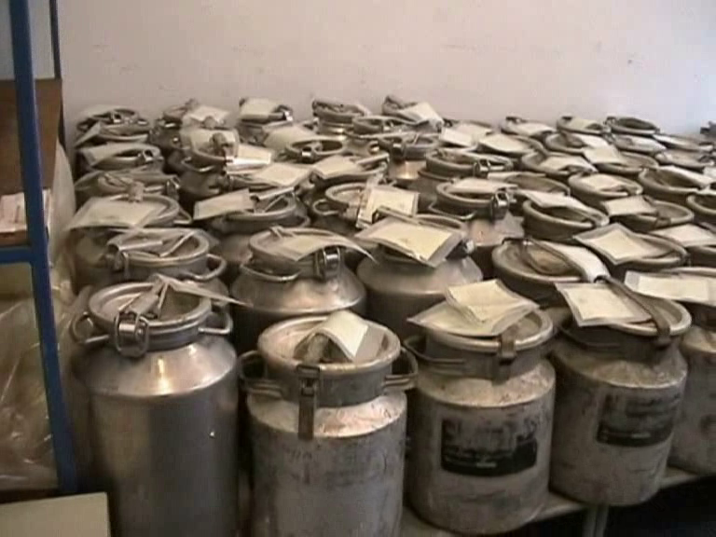

Slide 6
To minimize radon contamination, air for the entire manufacturing area, and especially in our two laboratories, is taken 25 meters above the ground and filtered prior to entering our facility.
We process each metal to remove unwanted elements and impurities.

Slide 7
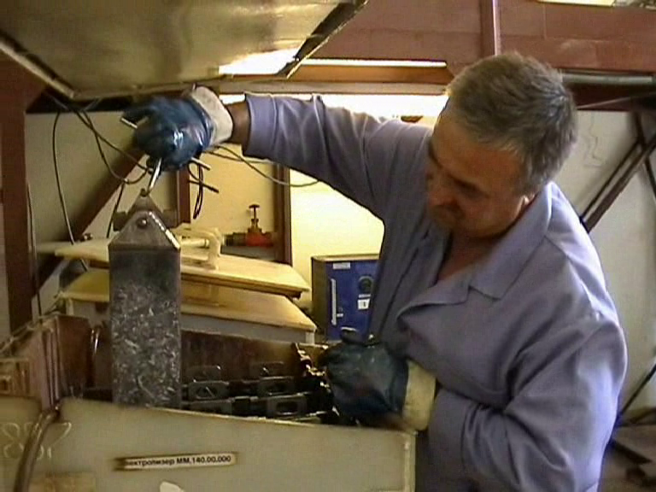

Slide 8
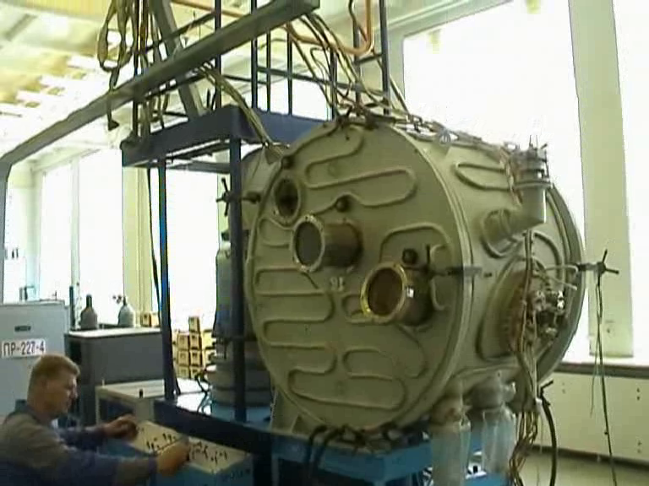
Then from each metal - the removal of radioactive isotopes and more testing.

Slide 9
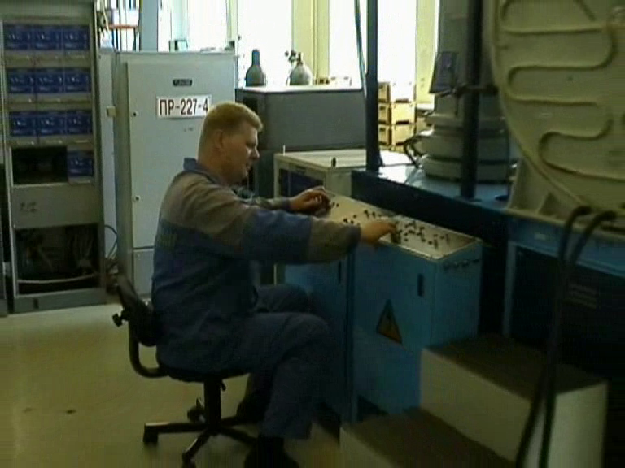

Slide 10
It is necessary to remove radioactive isotopes and especially Pb²¹⁰. Some firms tried removing Po²¹⁰ , an easier process, but the material will not be at secular equilibrium, as Pb²¹⁰ , higher in the decay chain, will continue to decay and emit more Po²¹⁰ , which will result in increasing alpha emissions over time. This method does not result in material that is in secular equilibrium and is not acceptable.

Slide 11
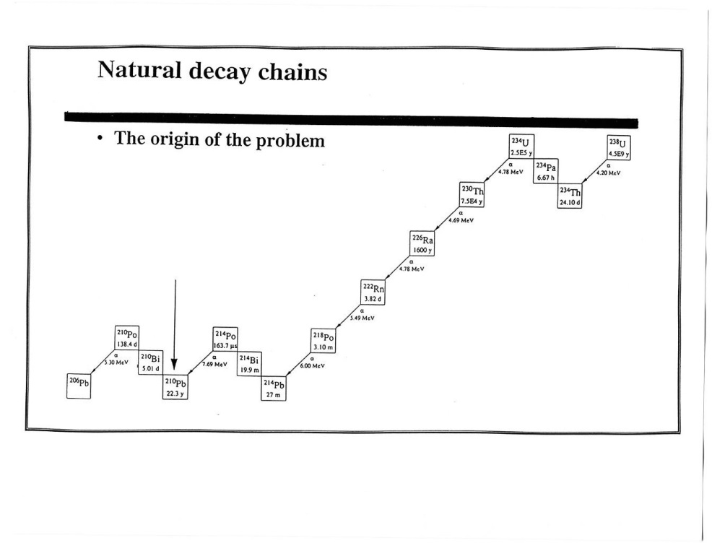
SECULAR EQUILIBRIUM is when the decay of Pb²¹⁰ is equal to or less than the decay of Po²¹⁰.

Slide 12
Let us talk about SULA TIN (Sn)… Today, the most-used metal is tin (Sn). A common concept is that to obtain SULA tin (0.001 cph/cm2), it is necessary to remove virtually all Pb in the tin (down to <0.1 ppm) from the tin. We feel that this concept and this tin may not maintain that alpha emission rate over time and could be a problem for customers.
It is well known that lead consists of 4 stable (non-radioactive) isotopes:
Pb²⁰⁴, Pb²⁰⁶, Pb²⁰⁷, Pb²⁰⁸ and one radioactive isotope Pb²¹⁰ ( Pb²¹⁰ produces Po²¹⁰ which is a major source of alpha particles ).
The problem is that the content of Pb²¹⁰ in different batches of tin concentrate can differ by 1000 and more times. We roughly calculated that the content of Pb²¹⁰ must be < 0.1ppb (not ppm but ppb) in order to get alpha emission rate of 0.001 cph/cm2. Trace amounts of Pb²⁰⁴ Pb²⁰⁶ Pb²⁰⁷ Pb²⁰⁸ are not a problem.
If we were to just reduce the content of lead in tin, even up to 0.01 ppm ( i.e. 10 ppb or less ) it does not automatically mean that the alpha emission of the tin is
< 0.001 cph/cm2 and that it is in secular equilibrium. According to our experience it is more important to remove Pb²¹⁰ and other alpha emitting sources. We know how to do this and therefore we produce SULA Tin < 0.001 cph/cm2 and also tin/lead alloys (0.001 cph/cm2) with any content of Lead : Sn100 + some % of impurities, alloys Sn90Pb10, Sn10Pb90, Sn63Pb37, etc.

Slide 13
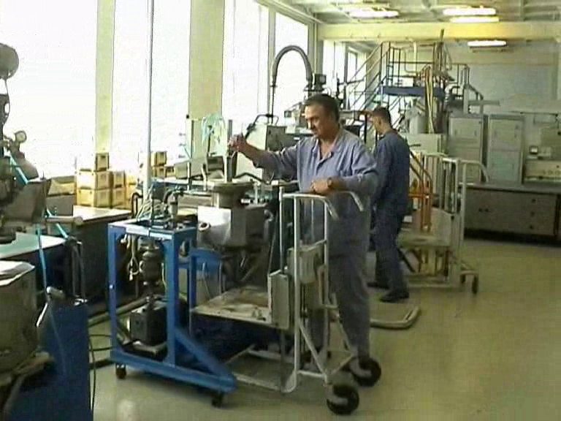

Slide 14
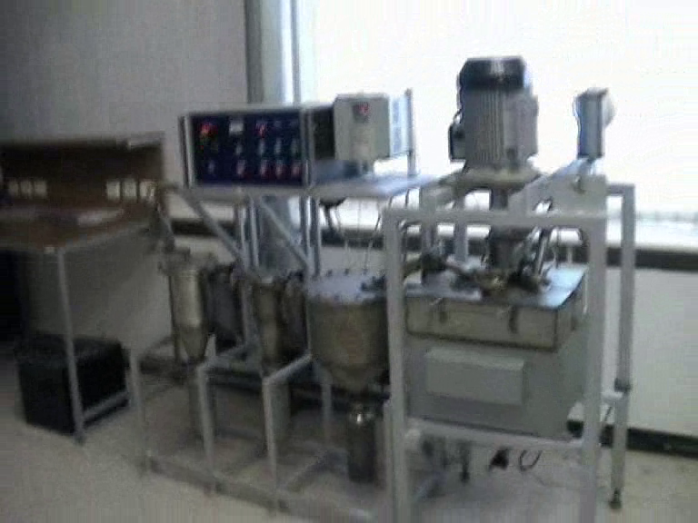

Slide 15
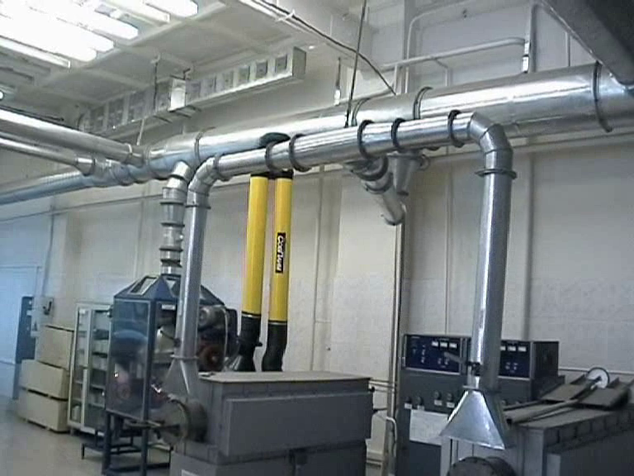

Slide 16
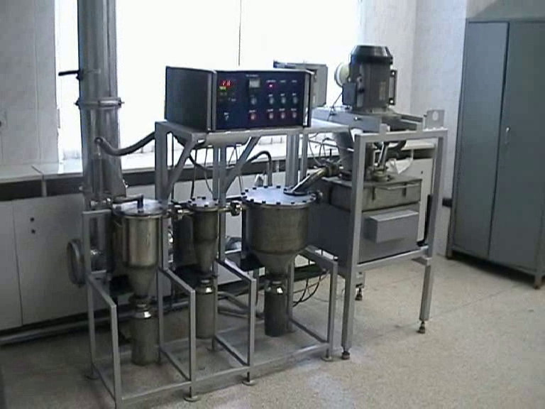

Slide 17
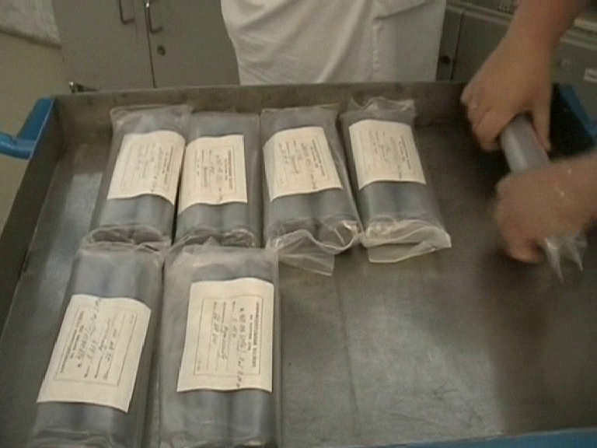

Slide 18
After processing, we test and then store each individual metal – tin, lead, copper, silver, etc. These metals are then ready for a customer’s order or for alloying and to be put into the required form/shape.

Slide 19
After the metal has undergone its processing and testing, it is stored for future use. We have found that by producing large batches – 500 kg or larger - results in efficiency in manufacturing and testing, even though more inventory is required.

Slide 20
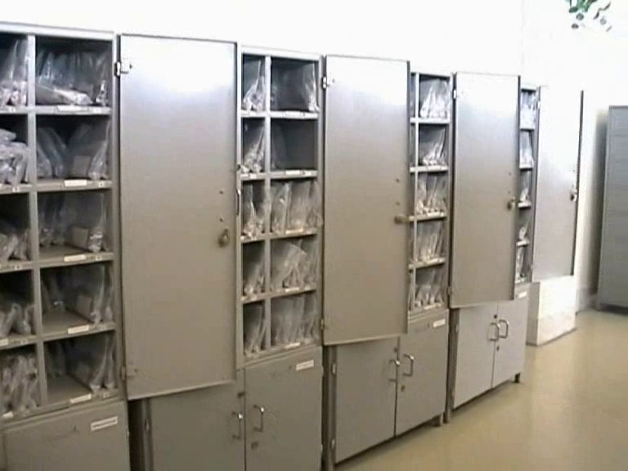

Slide 21
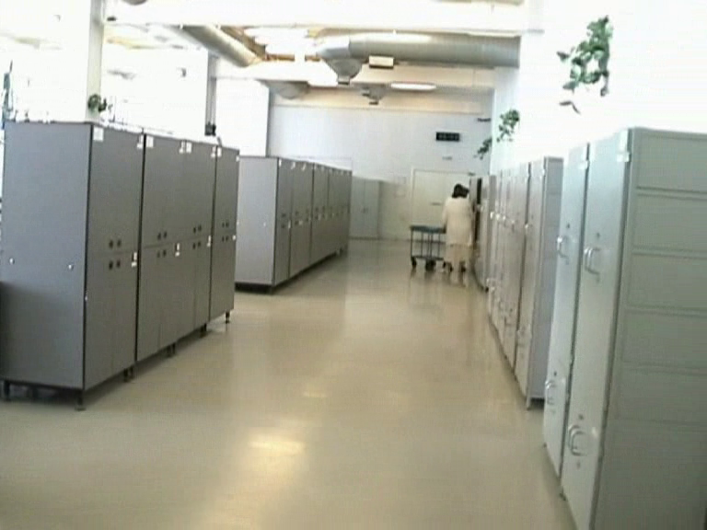

Slide 22
This inventory is necessary as it gives us the opportunity to test and retest the material over time so as to certify and guarantee that the material is at secular equilibrium and will not increase in alpha emissions. This maintains consistency.
The following slides show the repeated testing over time of various tin and alloys over time and our consistency.

Slide 23
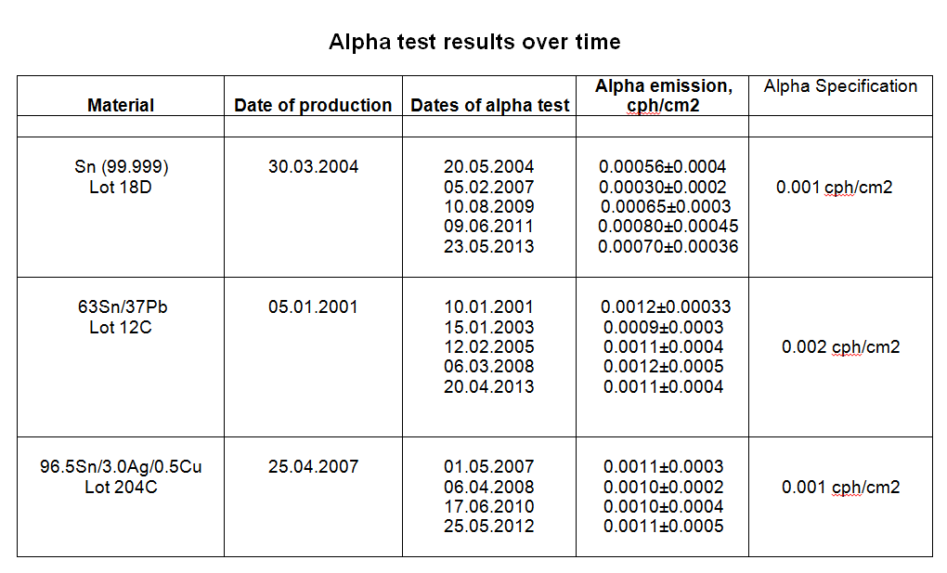

Slide 24
Upon receiving a customer’s specific order, the metal or metals required for an alloy are combined into a homogeneous batch. After alloying, this batch is again tested.

Slide 25
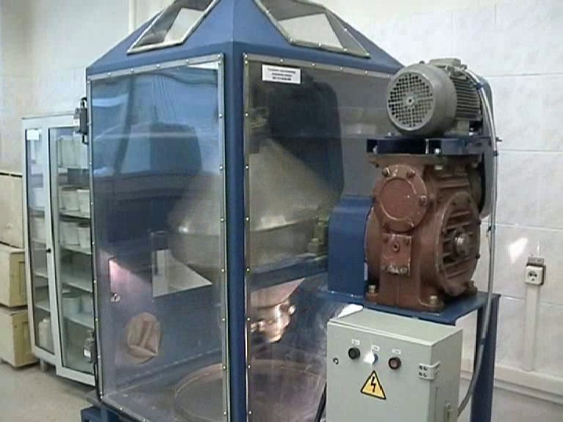

Slide 26
An archival sample of each batch is stored for future reference.
The tested material or alloy is then put into the required form or shape and then retested.

Slide 27
MEASUREMENT OF IMPURITIES AND ALPHA EMISSIONS

Slide 28
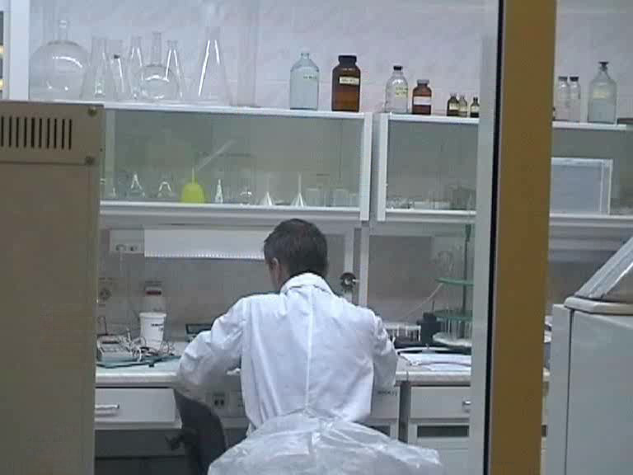
We use a calibrated ICP device for analysis of chemical elements. If a customer wants further analysis a sample can be sent to an independent laboratory for GDMS or other testing.

Slide 29
Sometimes a customer requires their own testing of a sample from their order prior to shipping, which is fine with us. We send a sample to them for their verification.

Slide 30
Alpha Measurement

Slide 31
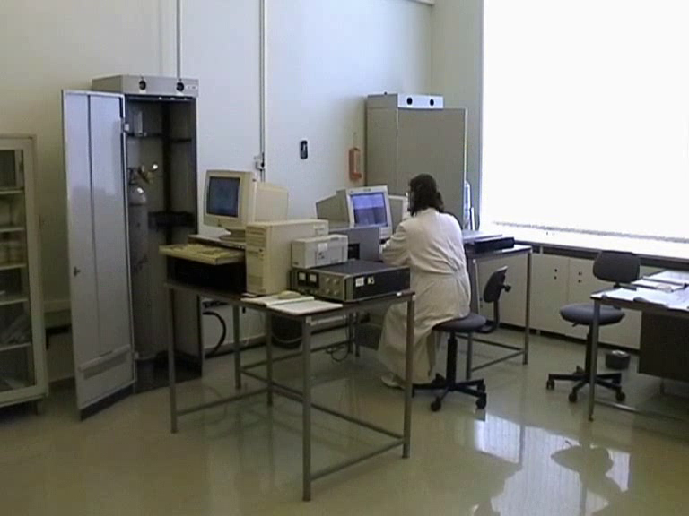
For the alpha measuring lab, in addition to taking air high above the ground and filtering it, we keep a positive pressure in this room to minimize any contamination.

Slide 32
Taking sufficient time to accurately measure the alpha emissions is very important.

Slide 33
In order to obtain accurate alpha emission measurements, we have found it necessary to take enough time to measure the background before and after measuring the sample. We average the background rate in determining the sample’s alpha emission rate.

Slide 34
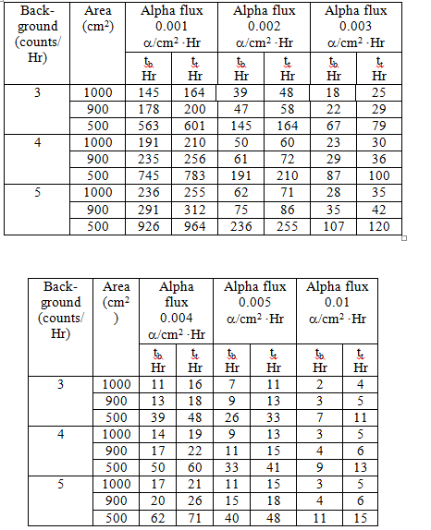

Slide 35
Peculiarities Of Measuring The Alpha Particle Activity Of Flat Samples
Of Metals, Alloys And Powders Using Gas Flow Proportional Counters
Specifically the Model 1950 Manufactured by “Spectrum Sciences”, USA
S.M. Zakharyasah, Y.B. Tolstukhin, I.V. Fedotova
Pure Technologies, LLC
177 US Hwy # 1; No. 306
Tequesta, FL 33469 USA
Tel. 404 351 6136 Fax. 877 738 8263
e-mail: info@puretechnologies website: www.puretechnologies.com
ABSTRACT
Naturally occurring radioactive emissions from solder (Pb/Sn or Pb-free) in semiconductor devices may result in memory device malfunctions and possible consequential product liability. These “soft errors” occur randomly but do not cause permanent physical damage to the memory cell. The principal product developed to reduce the probability of soft error malfunctions in memory devices is low alpha lead/tin alloys and low alpha lead-free alloys.
Notes:
Our colleagues produced a paper and copies of it is available on our website.

Slide 36
Copies of this paper are available on our website:
www.puretechnologies.com.

Slide 37
That concludes my presentation.
I shall try and answer any questions you may have.
Questions can be sent to me at:
jerry@puretechnologies.com

